Slide 1
Structure Chart
A structure chart represents the software architecture, i.e. the various modules making up the system, the dependency (which module calls which other modules), and the parameters that are passed among the different modules.
Since the main focus in a structure chart representation is on the module structure of the software and the interactions among different modules.

Slide 2
Symbols
The basic building blocks which are used to design structure charts are the following:
  • Rectangular boxes: Represents a module.

Slide 3
Symbols
• Module invocation arrows: Control is passed from one module to another module in the direction of the connecting arrow.

Slide 4
Symbols
Data flow arrows: Arrows are annotated with data name; named data passes from one module to another module in the direction of the arrow.
Data item
Data item

Slide 5
Symbols
Library modules: Represented by a rectangle with double edges.
• Repetition: Represented by a loop around the control flow arrow.
Library modules
Repetition

Slide 6
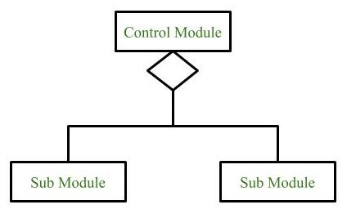
Symbols
•Selection: Represented by a diamond symbol.

Slide 7
Question
What is the outcome of Structure Design?
a) DFD
b) UML
c) Structural Chart
d) None of above

Slide 8
Transformation of a DFD Model into Structure Chart
Systematic techniques are available to transform the DFD representation of a problem into a module structure represented by as a structure chart. Structured design provides two strategies to guide transformation of a DFD into a structure chart:
Transform analysis
Transaction analysis

Slide 9
Transform analysis
Transform analysis identifies the primary functional components (modules) and the input and output data for these components. The first step in transform analysis is to divide the DFD into three types of parts:
• Input.
• Processing.
• Output.

Slide 10
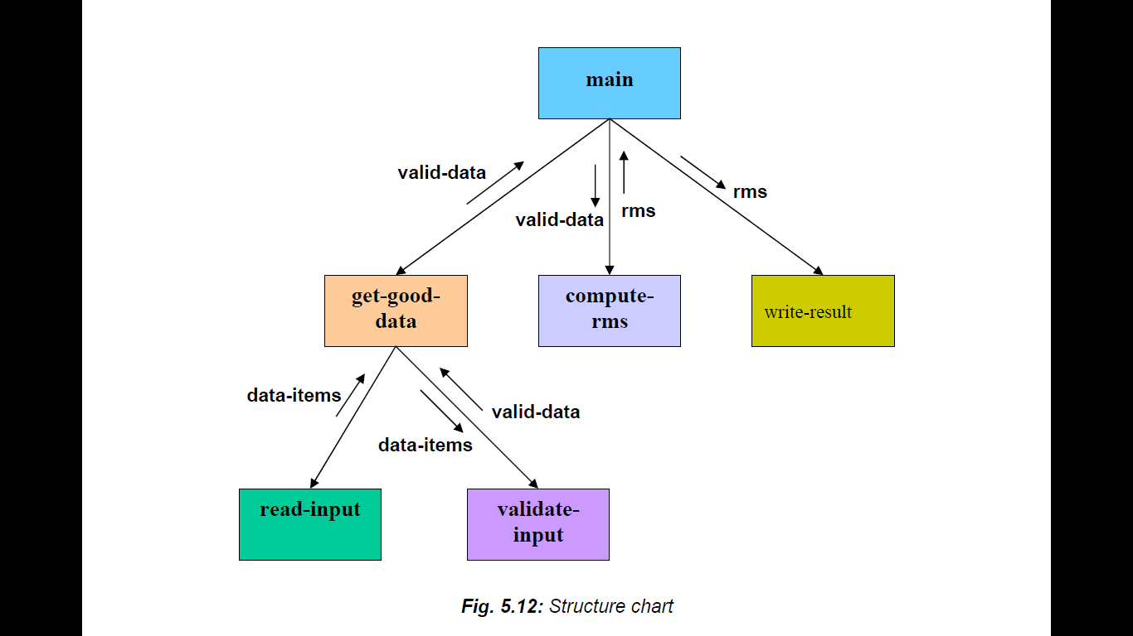
Example: Structure chart for the RMS software

Slide 11
Example: DFD for the RMS software
numbers
Read-numbers
0.1
Validate-numbers
0.2
Valid -numbers
Data-items
error
Compute-rms
0.3
Display
0.4
result
RMS

Slide 12
Question
What exactly module invocation arrow represent?
Data Flow
Control Pass
Data sharing
Non of above

Slide 13
Transaction analysis
Transaction analysis is an alternative to transform analysis and is useful while designing transaction processing programs.
A transaction allows the user to perform some specific type of work by using the software.
For example, ‘issue book’, ‘return book’, ‘query book’, etc., are transactions.

Slide 14
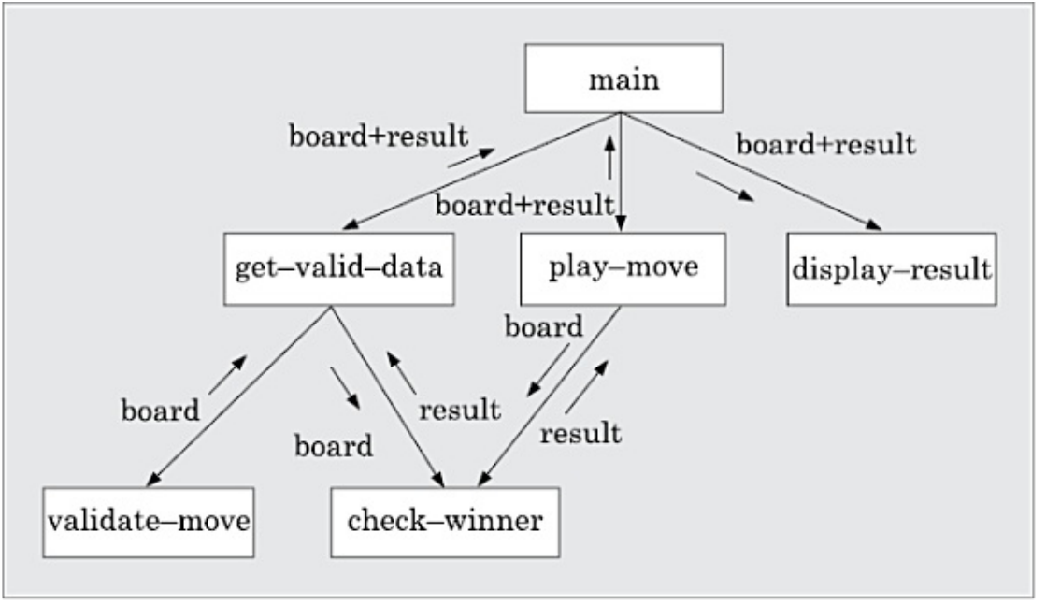
Example tic-tac-toe

